Slide 1
Low-Level Non-Invasive Laser Therapy for the Treatment of Ocular Refractive Disorders
Authors:
Jim Ohneck, Fellow ASLMS, Oculatek Inc., Laser Therapy Services, Inc.
David Friess, OD, Optimus Clinical Partners LLC

Slide 2
Oculatek, Inc.
Oculatek, Inc. based in Cleveland, OH, is a privately held corporation formed to adapt a novel, therapeutic, non-surgical ophthalmic technology utilizing low intensity light to treat vision disorders, such as progressive myopia and presbyopia.
Oculatek has the world wide patent rights to the technology used in the device.

Slide 3
What is Trans-scleral Laser Therapy
Trans-scleral laser therapy is a technique to eliminate the accommodation derangement and normalize ciliary muscle function.
The effect of infrared low energy laser radiation on the ciliary muscle has been demonstrated to increase metabolism in the cells of the ciliary body and to improve ocular hemodynamics.

Slide 4
History of Technology
In 1991-1994, specialists of the Helmholtz Moscow Research Institute of Eye Diseases, in cooperation with experts at MACDEL company in Moscow, developed and performed experimental and clinical testing of the curing method for eye accommodation disorders for myopia and visual fatigue. This method provided trans-scleral contact free influence on the ciliary muscle using infrared laser radiation with the wavelength of 1300nm.
(E.B. Anikina, E.I. Shapiro, and 6, G.L. Gubkina, 1994; E.S. Avetisov et al., 1997)

Slide 5
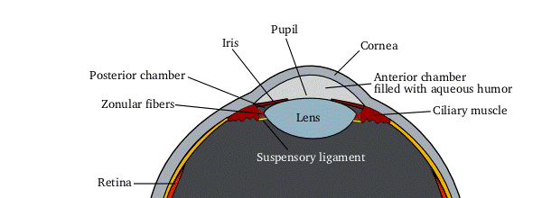
How It Works
Directs low energy infrared light at ciliary muscle
Wavelength selected to optimize photo-biological effect
Stimulates mitochondrial function, increases blood flow, and ciliary muscle strength and mobility
Improves lens movement and accommodation reserve
Improvement seen after three treatments of 9 minutes each
Oculatek Device

Slide 6
Eye Tissue Study (experimental)
Laser beam targeted through sclera at prelimbic areas of ciliary body projection in 3 and 9 hour zones of rabbit eyes. Irradiation by 0.2 J/cm² (low radiation) and 2 J/cm² (high radiation) for three minutes over ten sessions.
After irradiation 7 and 30 days, respectively, 22 Chinchilla rabbit eyes were enucleated and morphological study was performed. Six non-irradiated eyes were taken for control.

Slide 7
Eye Tissue Study (highlights)
Morphological studies showed no destructive changes in any of the treated eyes.
Low energy doses (0.2 J/cm² ) caused positive effect intensifying metabolic activity of both epithelial cells and connective tissue of ciliary body.
An assembly of mitochondria, higher expressed than in control was observed. This is associated with intensification of oxygen dependent processes aimed at activation of intracellular metabolism.
Histochemical studies indicated accumulation of glycosaminoglycans in the connective tissue of the ciliary body that were not present in the control.
High dose radiation did not appear to have the same effect.

Slide 8
Epithelial Cell from Rabbit Study
Ultrastructure of epithelial cell in the ciliary body after low energy laser irradiation. Multiple mitochondria (M) in the cell cytoplasm; ×14,000.

Slide 9
Experimental to Clinical Study Model
Positive experimental results led to clinical study methodology.
At the sclera level the 1300nm radiation was set to 2mw, this dose was 2 orders of magnitude below the MPL (maximum permissible level) (S.D. Plentev, 1981).
At the ciliary body level the laser intensity density with respect to the scleral transparency is less than 10⁻³ W/cm²
The same 3 and 9 hour zones were used and each zone was irradiated for 3 minutes.
Energy exposure at ciliary body equaled 0.2 J/cm², 100 times below MPL.

Slide 10
“Trans-scleral Laser Effect on Weakened Ciliary Muscle”, G.L Gubkina
In 1992-1994 clinical studies were performed on 68 children (136 eyes) aged 7-17 with progressive myopia from 0.5 to 3.0 D.
Laser radiation effect on eye accommodative ability of eyes was assessed by measuring relative accommodation, the nearest point of clear vision and from rheoophthalmography results.

Slide 11
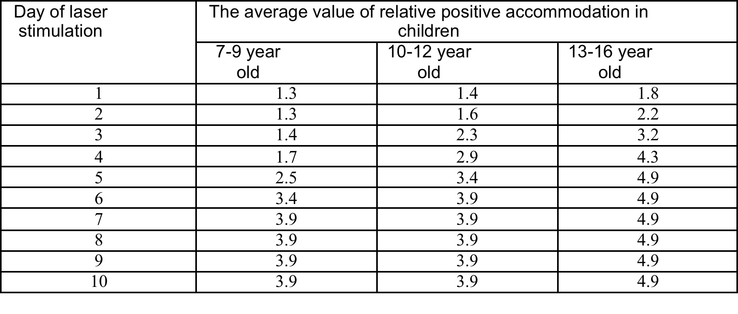
Positive accommodation changes
The change of relative positive accommodation (D) by days of laser stimulation
Notes:
The average increase of the accommodation reserve per day of laser therapy equaled 0.3 D. Hence, gradual increase of the reserve was observed during primary five days of laser stimulation. This increase was slowed down during 7th to 10th day, which gave 0.1 D per day. Further measurements were almost the same and gave the average relative positive accommodation at the same level.
In teenagers and elder children, the positive (reserve) relative accommodation noticeably increases since the 3rd day of laser stimulation. In younger children, the increase was slower, and the relative accommodation reserve increased since day 4-5. After day 7-8 of laser stimulation, relative accommodation reserves did not change.

Slide 12
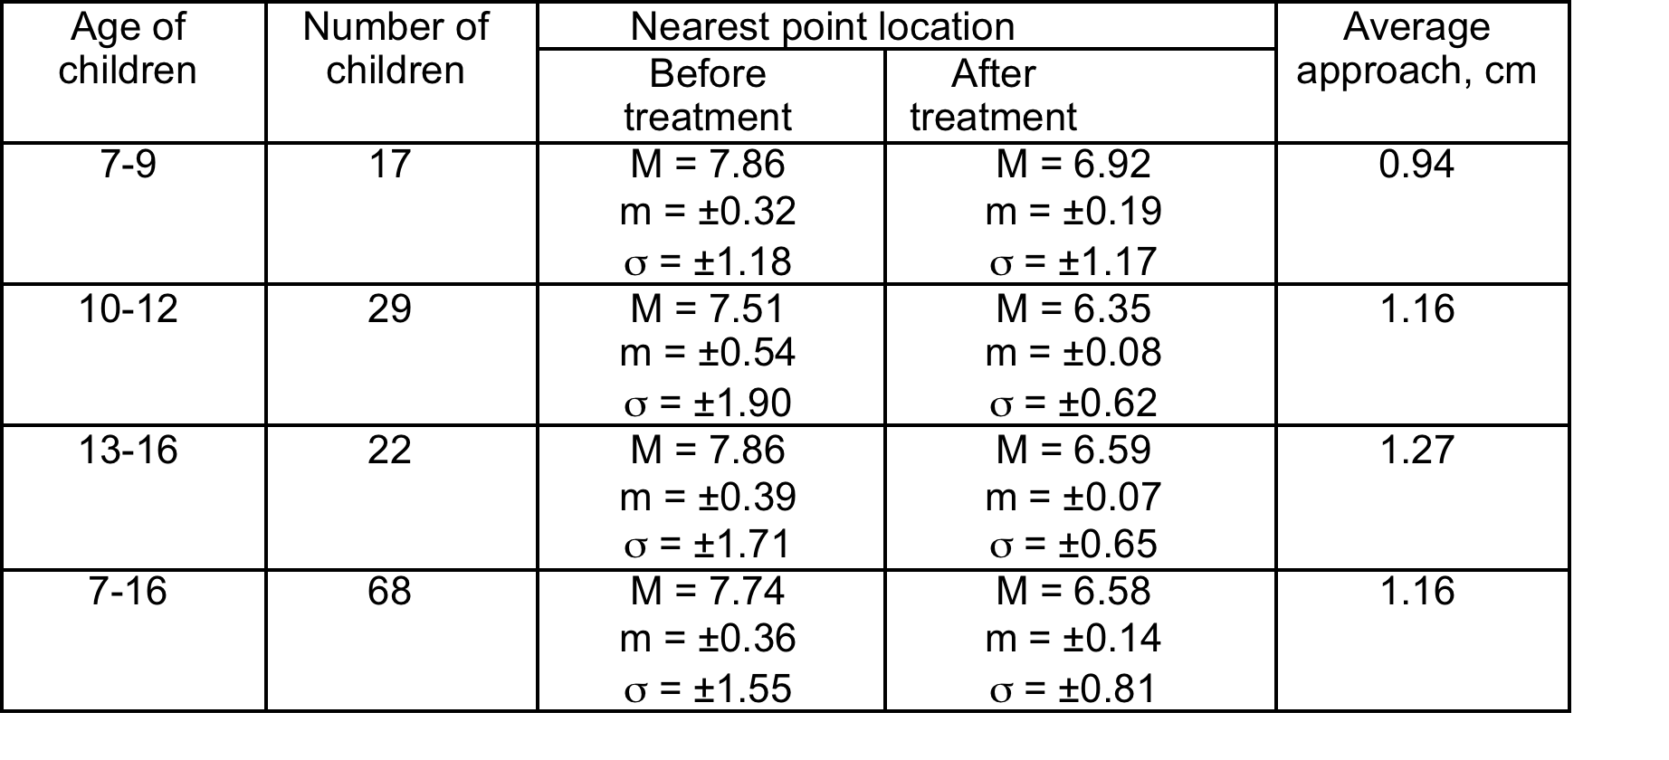
Nearest Point of Clear Vision, cm
Location of the nearest point of clear vision before and after laser stimulation
Notes:
As may be seen, more significant shift of the nearest point of clear vision was observed in children 13-16 years old. The nearest point of clear vision in them approached the eye by 1.27 cm, which equals 2.4 D, and children 10–12 years old with approach by 1.16 cm (2.2 D). Shorter approach was observed in children 7-9 years old – 0.94 cm (0.7 D).
Since laser stimulation induced sufficient change in location of the nearest point of clear vision was observed in children 10-16 years old, one may assume that younger children possess some age-specific weakness of accommodation apparatus of eyes.

Slide 13
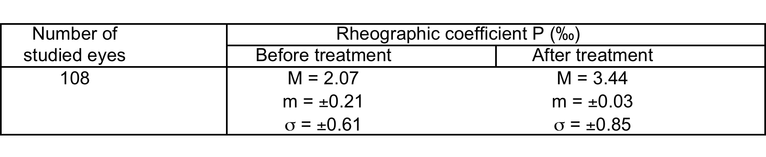
Rheographic Coefficient
Rheographic coefficient in children with lower myopia before and after laser stimulation
Notes:
This Table indicates a noticeable decrease of rheological coefficient in persons with lower myopia. In control persons with emmetropic refraction possess rheoophthalmographic coefficient equal 4.8 ± 1.31.
Rheographic studies show that the blood volume in ciliary body vessels reliably increases after laser stimulation, e.g. perfusion of the ciliary muscle and, consequently, its function is improved.
In all cases, laser therapy caused average increase of rheographic coefficient from 2.07‰ (m = ±0.21; σ = ±0.61) to 3.44‰ (m = ±0.03; σ = ±0.85). Thus, on average, the blood supply increased by 1.35‰, which indicated the reliable increase of blood filling of vessels in the ciliary muscle.

Slide 14
Dynamics of Relative Accommodation (RAR)
Dynamics of relative accommodation reserve (RAR) in myopic children in different periods after laser stimulation
Notes:
Dynamic examination shows that the positive (reserve) relative accommodation (RAR), location of the nearest point of clear vision, and indices of rheoophthalmography are above initial values during 3 months after the treatment completion. The decrease of indices is observed 5-6 months after the treatment. The repeated course of treatment allows normalization of the indices

Slide 15
Summary of Studies
In total fourteen Studies over a fifteen year period!

Slide 16
Changes Over Time
Dynamics of accommodation reserve change
Diopter
Months
Notes:
Dynamics of accommodation indices corresponded to the above-mentioned one: RAR significantly increased after every course of laser stimulation with subsequent gradual decrease (by 0.76 D, on average) and following increase after repeated course. Generally, RAR indices remained at the level of (-2.57 ± 0.9) D during the whole observation period, which reliably exceeds the initial range of (-1.4 ± 0.7) D.
On average, AL increased by 0.7 mm during observation in the whole group, whereas in control it gave 1.2 mm. Treatment increased rheographic coefficient from initial (2.1 ± 0.03%) to (3.4 ± 0.02%).
Best corrected visual acuity of vision remained equal 1.0 (20/20 by Snellen) both at the beginning and at the end of observations. Measurements in central (myopic cones) and peripheral sections of fundus of the eye corresponded to natural proceeding of myopia and were not more frequent than in untreated patients.
No signs of irritation of the ciliary body, external eye shells, as well as damaging impacts on retina and visual nerve were observed. The last statement is confirmed by functional (perimetry) and electrophysiological studies carried out in 15 patients, randomly selected from the group of treated patients.
After treatment, intraocular pressure (IOP) remained unchanged, though in some patients it decreased by 2 mmHg two weeks after the course and restored its initial level within 3-4 weeks.

Slide 17
Five Year Refraction Changes
Diopters
Years
Notes:
Shows the change over 5 years the laser makes

Slide 18
Early Studies in Presbyopia (USA)
Zelman Study, Ophthalmologist in West Chester, NY - 2007 - 12 patient study
Results
  100% of emmetropes with an initial ADD between 2D-3D eliminated their reading glasses
  75% of patients with < 2D ADD whether emmetropes or not eliminated their readers
  Remaining patients had reduced need for readers
  Subjectively 72% of the patients were either very satisfied or satisfied with their result
Notes:
Now I make the transition to Presbyopia and will explain verbally what led to investigating this.

Slide 19
Early Studies in Presbyopia (USA)
Kassalow: Optometrist in New York, NY -2008 - 12 patient IRB approved study
  3 treatments of 9 minutes versus recommended protocol of 6 treatments at 9 minutes
  Tear test and IOP measured after each treatment
  No adverse reactions or events
  Results
  67% Positive change after only three 9 minute treatments
  6 patients .5 diopters or more change
  3 patients 1.25 or more
  1 patient 1.75 change
  3 Patients eliminated readers
  5 reduced the dependence to 75%
  4 reduced some dependency by 25%

Slide 20

The Future of Trans-scleral Laser Therapy
Device is not FDA cleared at this time
Larger clinical trial needed for FDA clearance
Regulatory expectation is a Denovo 510(k)
Technology is sold today in Eastern Europe
Therapeutic device is a different approach here in the USA

